Slide 1
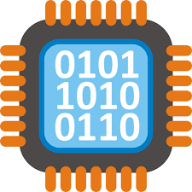
Binary Number
System
Computer Organization

Slide 2


1. Intro
Lesson 0 Review
Base 10
Base 2
Conversion between bases
Practice Conversion
Representing Characters using binary
Two’s Complement - Representing Negative Numbers using binary
Practice Conversion

Slide 3
Computer Organization first step for chip designers, compiler/OS writers. Better and more secure software.
Notes:
Computer Organization is an important first step for chip makers like Intel and AMD.
A compiler is a computer program that translates computer code written in one programming language (the source language) into another language (the target language). The name "compiler" is primarily used for programs that translate source code from a high-level programming language to a lower level language (e.g. assembly language, object code, or machine code) to create an executable program.
A compiler is likely to perform some or all of the following operations, often called phases: preprocessing, lexical analysis, parsing, semantic analysis (syntax-directed translation), conversion of input programs to an intermediate representation, code optimization and code generation. Compilers generally implement these phases as modular components, promoting efficient design and correctness of transformations of source input to target output.
At a high level the Operating System is an intermediate software layer between the user and computer hardware.
Understanding low level system architecture helps you write better and more secure programs. For example,
Determine how far you might be from optimal performance.
Simple things to do to speed up the code. Branching, Loops, etch
Know when to invest in code rather than hardware.

Slide 4
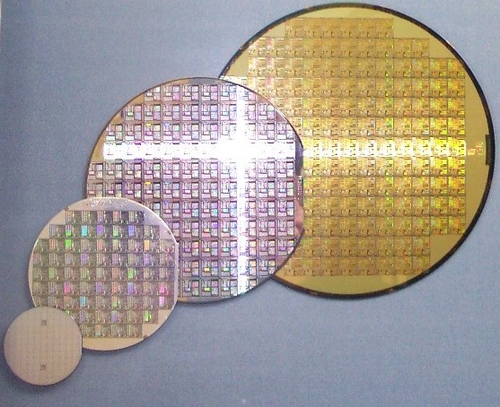
Notes:
Manufacturing Process
Silicon wafers undergo many processing steps so that different parts of the wafer behave as insulators, conductors, and transistors (switches)
Multiple metal layers on the silicon enable connections between transistors
The wafer is chopped into many dies - the size of the die determines yield and cost

Slide 5
Why should a programmer care about hardware?
Notes:
Must know how to reason about program performance and energy and security
Memory Management: if we understand how/where data is placed, we can help ensure that relevant data is nearby
Thread Management: if we understand how threads interact, we can write smarter multi-threaded programs
Why should we care about multi-threaded programs?
Multithreading leads to minimization and more efficient use of computing resources. Application responsiveness is improved as requests from one thread do not block requests from other threads. Additionally, multithreading is less resource-intensive than running multiple processes at the same time.
Multithreading is the ability of a central processing unit (CPU) (or a single core in a multi-core processor) to provide multiple threads of execution concurrently, supported by the operating system. This approach differs from multiprocessing. In a multithreaded application, the threads share the resources of a single or multiple cores, which include the computing units, the CPU caches, and the translation lookaside buffer (TLB).

Slide 6
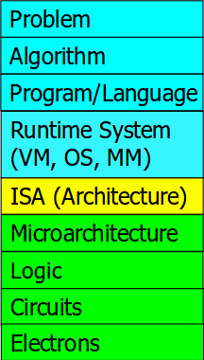
Computer Architecture
Levels of Transformation
Notes:
Why should we worry about knowing it?
If you master both hardware and software (and the interface between them):
1) Can develop better software if you understand the hardware
2) Can design better hardware if you know the software
3) Can create a better computing system if you understand both

Slide 7
Application software
a[i] = b[i] + c;
compiler
lw $15, 0($2)
add $16, $15, $14
add $17, $15, $13
lw $18, 0($12)
lw $19, 0($17)
add $20, $18, $19
sw $20, 0($16)
Systems software
(OS, compiler)
assembler
000000101100000
110100000100010
...
Hardware

Slide 8
Base 10

Slide 9
Base 10 (decimal)
0 1 2 3 4 5 6 7 8 9
digits
431

Slide 10
Base 10 (decimal)
10000 | 1000 | 100 | 10 | 1
 |  | 4 | 3 | 1
(4 * 100) + (3 * 10) + (1 * 1) = 431

Slide 11
Convert Base 10 to Base 2
10000 | 1000 | 100 | 10 | 1
 |  | 2 | 3 | 1
128 | 64 | 32 | 16 | 8 | 4 | 2 | 1
1 | 1 | 1 | 0 | 0 | 1 | 1 | 1

Slide 12
Base 2

Slide 13
Base 2 (binary)
0 1
binary digits (bits)
00100101

Slide 14
Base 2 (binary)
128 | 64 | 32 | 16 | 8 | 4 | 2 | 1
0 | 0 | 1 | 0 | 0 | 1 | 0 | 1
(1 * 32) + (1 * 4) + (1 * 1) = 37

Slide 15
Convert Base 2 to Base 10
128 | 64 | 32 | 16 | 8 | 4 | 2 | 1=2^0
0 | 1 | 1 | 0 | 1 | 1 | 0 | 1
?

Slide 16
What is the biggest number that you can represent in binary using 8 bits?
How many decimal numbers can you represent in binary using 8 bits?
255
256

Slide 17
Convert Base 2 to Base 10
128 | 64 | 32 | 16 | 8 | 4 | 2 | 1
1 | 1 | 1 | 1 | 1 | 1 | 1 | 1
(1 * 128) + (1 * 64) + (1 * 32) + (1 * 16) + (1 * 8) + (1 * 4) + (1 * 2) + (1 * 1) + = 255
0 to 255 how many decimal numbers … 256

Slide 18
Practice Conversion

Slide 19
Base 2 (binary) to Base 10 (decimal)
00000101 01111111
00010101 00111100
01001010 11000011
10101010 11111111

Slide 20
Base 10 (decimal) to Base 2 (binary)
27 132
64 48
130 10
7 255

Slide 21
Representing Characters using binary
Notes:
Two's complement is a mathematical operation on binary numbers, and is an example of a radix complement. It is used in computing as a method of signed number representation.
Everything represented by a computer is represented by binary sequences.
A common non-integer to be represented is a character. We use standard encodings (binary sequences) to represent characters.
REMEMBER: bit patterns do NOT imply a representation
An 8-bit binary quantity is called a byte.
Many I/O devices work with 8-bit quantities. A standard code ASCII (American Standard for Computer Information Interchange) defines what character is represented by each sequence. You'll look these up in an ASCII table.

Slide 22
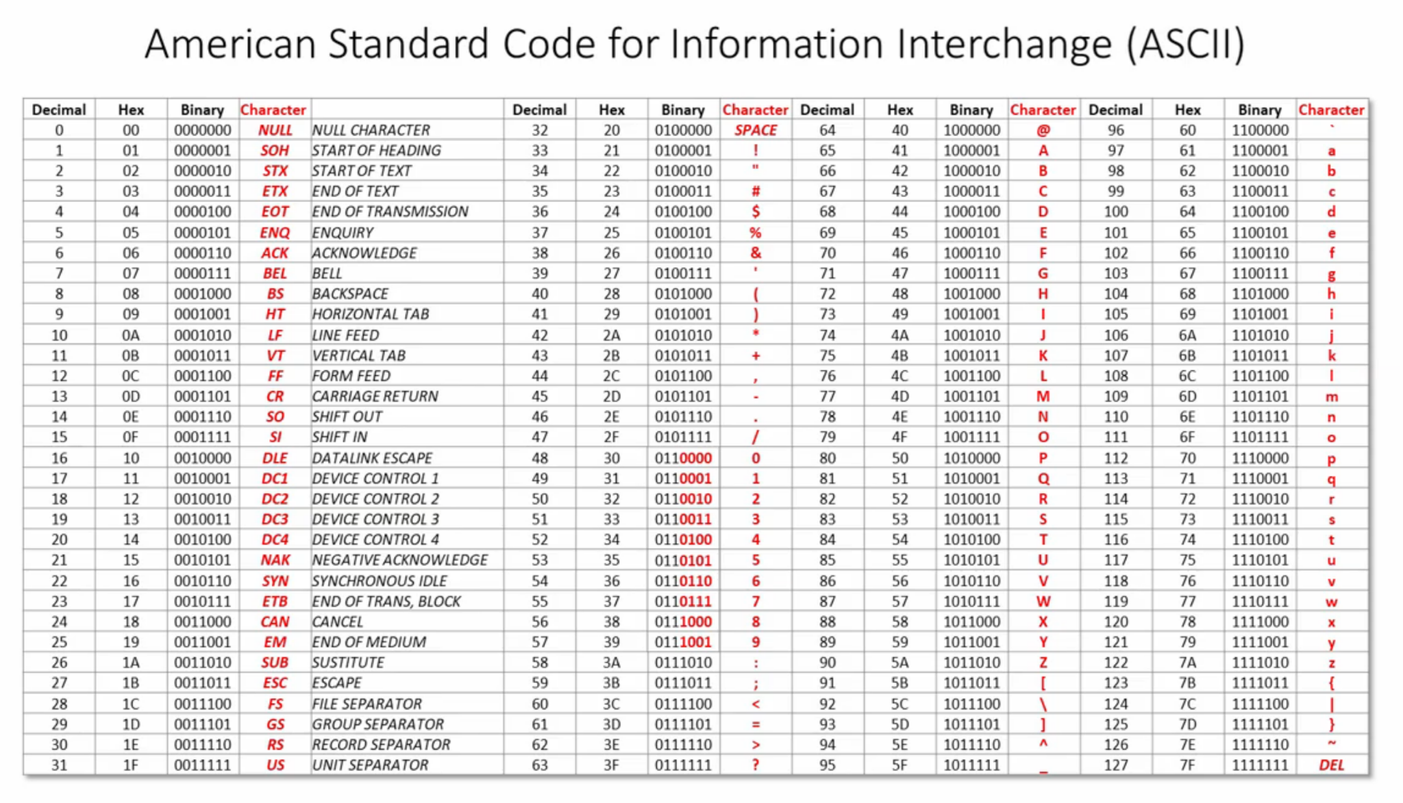
Notes:
ASCII abbreviated from American Standard Code for Information Interchange, is a character encoding standard for electronic communication. ASCII codes represent text in computers, telecommunications equipment, and other devices. Most modern character-encoding schemes are based on ASCII, although they support many additional characters.
The Internet Assigned Numbers Authority (IANA) prefers the name US-ASCII for this character encoding.
Different bit patterns are used for each different character that needs to be represented.
Because of this difference between the integer representation for a character, and the character representation for a character, we constantly need to convert from one to the other.
The computer does arithmetic operations on two's complement integers (and often operations on unsigned integers). The computer has the ability to read in or print out a single character representation at a time. So, any time we want to do I/O, we're working with one character at a time, and the ASCII representation of the character. Yet, lots of the time, the data represents numbers (just consider integers, for now).
8-bits increased the number of characters range.
Early on most computer manufacturers where creating their own set of characters. Microsoft and IBM each made dozens. Know as codepages.
It became platform dependent
WWW increased this problem
When data moved from one place to another possibly different system or storage devices. Data was not well represented.
Then, it came Unicode
The idea was to create a single character set in which every single platform has a unique character.

Slide 23

Notes:
Unicode is an information technology standard for the consistent encoding, representation, and handling of text expressed in most of the world's writing systems. The standard, which is maintained by the Unicode Consortium, defines 143,859 characters covering 154 modern and historic scripts, as well as symbols, emoji, and non-visual control and formatting codes. Unicode 14.0 is now in beta with 144,697 characters, including 5 new scripts, and 37 new emoji characters.

Slide 24
Design Goals of Unicode
Unique code point for every possible character
Backwards compatibility with ASCII
Space efficient
Allow for efficient data transmission
00000000 00000000 00000000 01000001

Slide 25
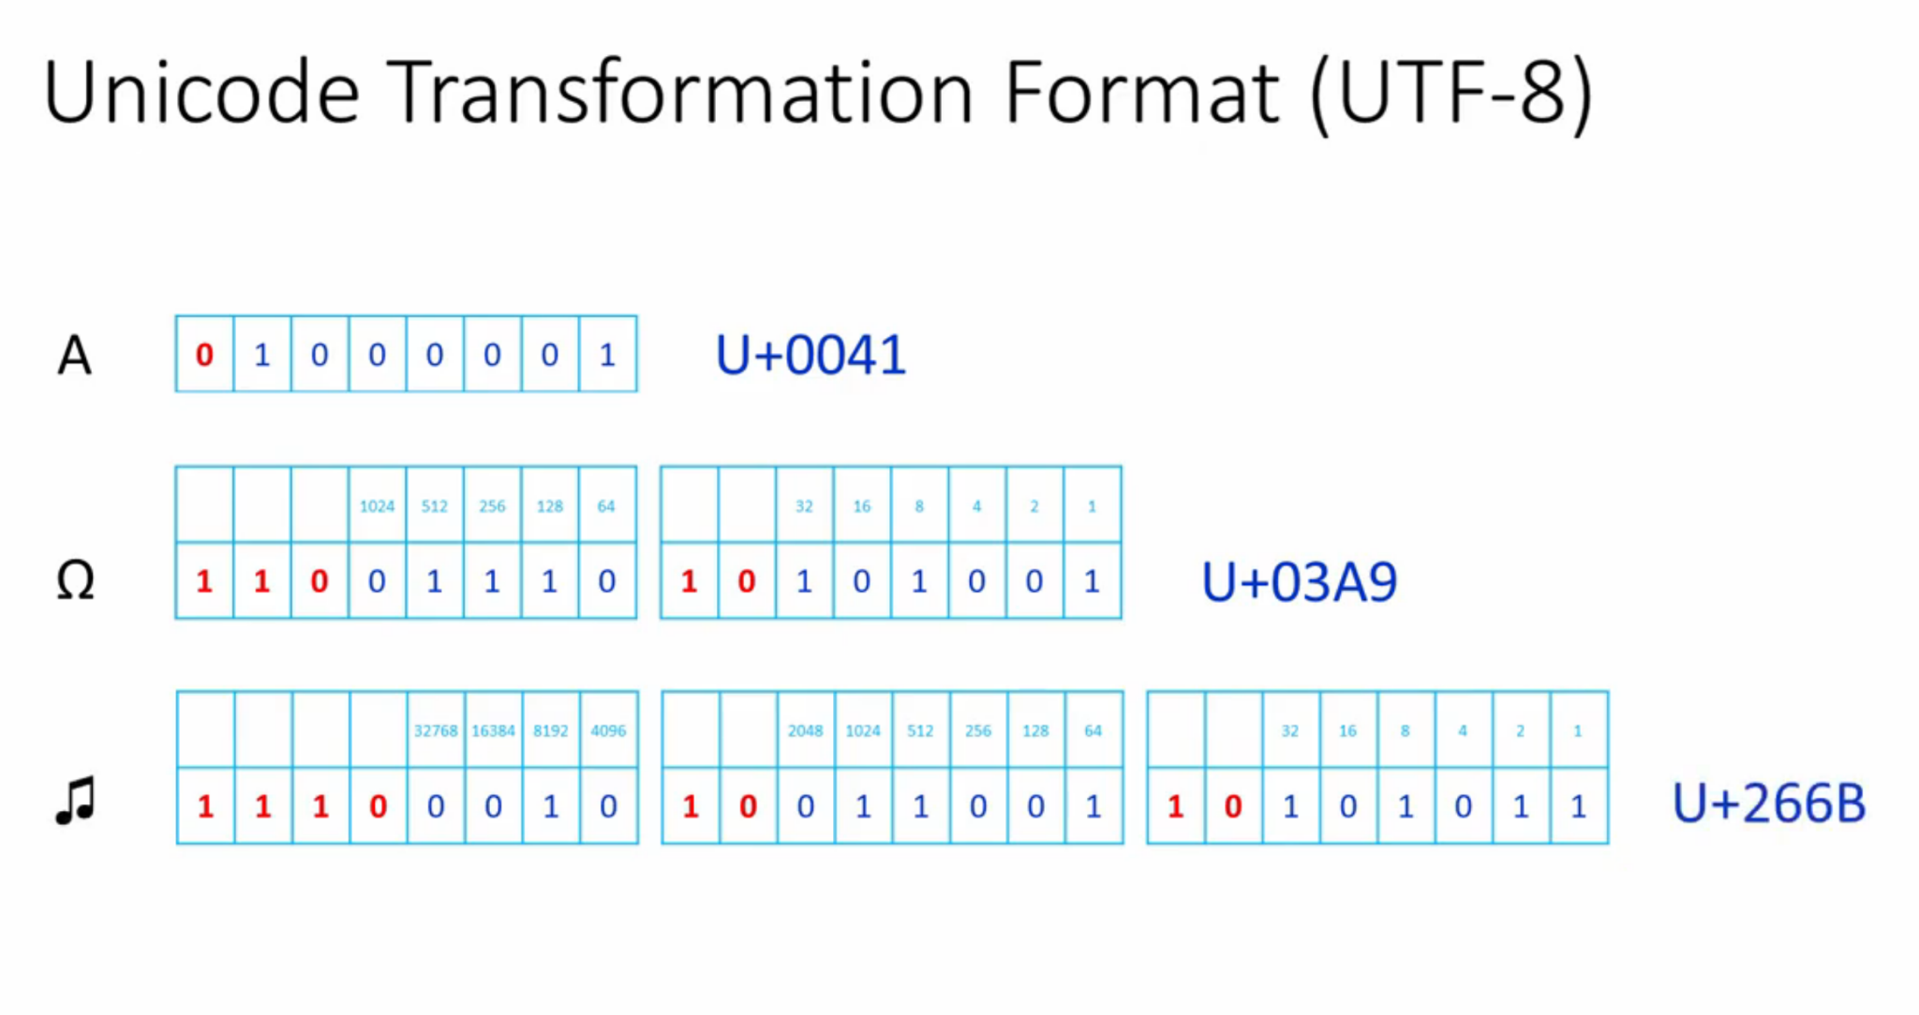

Slide 26
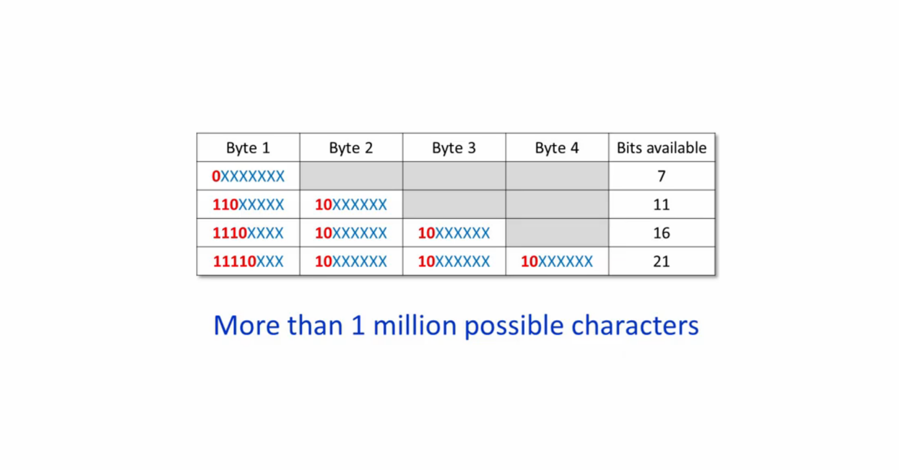

Slide 27
Summary
ASCII is a 7 bit encoding system for a limited number of characters
Extended ASCII resulted in lots of incompatible code pages
Unicode allows every character in every written language to be encoded
Unicode is backwards compatible with ASCII
Unicode is space efficient
Unicode Transformation Format (UTF-8) uses 1, 2, 3 or 4 bytes
Unicode is universally supported

Slide 28
Two’s Complement
Representing Negative Numbers using binary

Slide 29
Convert Base 2 to Base 10
128 | 64 | 32 | 16 | 8 | 4 | 2 | 1
0 | 1 | 1 | 0 | 1 | 1 | 0 | 1
109

Slide 30
Representing -34
-128 | 64 | 32 | 16 | 8 | 4 | 2 | 1
1 | 1 | 0 | 1 | 1 | 1 | 1 | 0
-128 + 64 + 16 + 8 + 4 + 2 = -34

Slide 31
9 6
- 3 4
6 2

Slide 32
1
1
0 | 1 | 1 | 0 | 0 | 0 | 0 | 0
1 | 1 | 0 | 1 | 1 | 1 | 1 | 0
0 | 0 | 1 | 1 | 1 | 1 | 1 | 0
96
-34
62

Slide 33
Convert -8 into 8 bit binary
-128 | 64 | 32 | 16 | 8 | 4 | 2 | 1
1 | 1 | 1 | 1 | 1 | 0 | 0 | 0
-128 + 64 + 32 +16 + 8 = -8

Slide 34
Convert -24 into 8 bit binary
-128 | 64 | 32 | 16 | 8 | 4 | 2 | 1
1 | 1 | 1 | 0 | 1 | 0 | 0 | 0
-128 + 64 + 32 + 8 = -24

Slide 35
Special sequence
-128 | 64 | 32 | 16 | 8 | 4 | 2 | 1
1 | 1 | 1 | 1 | 1 | 1 | 1 | 1
-128 + 64 + 32 + 16 + 8 + 4 + 2 + 1= -1

Slide 36
Special sequence
-128 | 64 | 32 | 16 | 8 | 4 | 2 | 1
0 | 1 | 1 | 1 | 1 | 1 | 1 | 1
64 + 32 + 16 + 8 + 4 + 2 + 1= 127

Slide 37
Special sequence
-128 | 64 | 32 | 16 | 8 | 4 | 2 | 1
1 | 0 | 0 | 0 | 0 | 0 | 0 | 0
-128

Slide 38
Summary
Computers use two’s complement to represent negative numbers in binary
Half of the available combinations of bits are used to represent negative numbers

Slide 39
Practice Conversion

Slide 40
Binary, Decimal and Negative Numbers
11010101 -1
11110000 -42
00001111 -89
11100111 12

Slide 41
2. End
Collaborate on FSBS
Base 2 to base 10 conversion
Complete practice problems
Download Logisim-evolution
Test that you are able to run on your computer.

